Slide 1


Revolutionizing
Exosome Based
Therapeutics
EXOUSIA PRO

Slide 2


Mission Statement
Our mission is to lead in the research, development, and manufacturing of both plant-based and mammalian exosome technologies—harnessing the power of cellular communication to advance preventative and regenerative healthcare.
Through this innovation, we aim to promote well-being and empower people to live longer, healthier lives.
EXOUSIA PRO

Slide 3
What makes us unique
We are revolutionizing the potential of plant-derived exosomes as a botanical substitute for human exosomes.
State-of-the-Art exosome lab facilities to produce mammalian and plant-based production of non-immunogenic exosomes.
Alliance Agreement between Exousia Pro and Progenicyte Japan Co., LTD (PJC), which owns a patent-pending transformational drug delivery platform that utilizes exosomes to deliver nucleic acids to tissue and cells.
EXOUSIA PRO

Slide 4
Exosomes: Nature’s Delivery Vehicles
Nano-sized vesicles (30-150 nanometers in size), secreted by nearly all cells.
Encapsulate and transport bioactive molecules (RNAs, proteins, lipids).
Function as molecular cargo transporters of proteins, lipids, and genetic material, influencing the behavior and fate of recipient cells.
Exosomes have great potential in diagnostics, therapy, and regenerative medicine, supporting medical research and advanced treatments.
EXOUSIA PRO

Slide 5
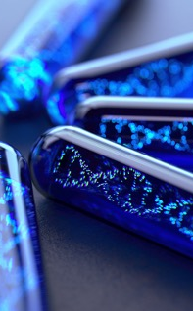
Applications of Exosome Technology in Dermatology
Treat skin aging linked to oxidative stress; wrinkles, dry skin, loss of elasticity.
Stimulate collagen production in fibroblasts to maintain skin structure.
Improve skin strength and skin elasticity.
Skin tightening and reducing signs of aging; Plasma Pen treatment.
EXOUSIA PRO

Slide 6
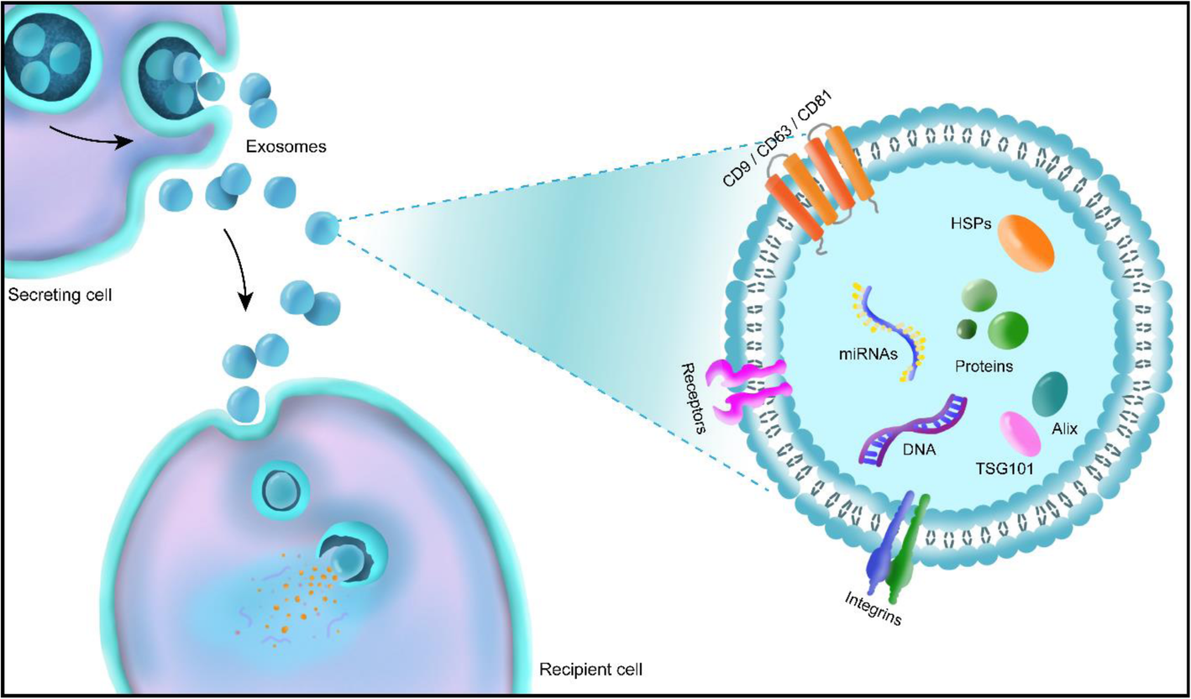
Snapshot of Proprietary Mushroom-based Exosome
Bioactive Ingredients:
L-Ergothioneine
Beta-glucans
Terpenoids
Phenolic compounds
Vitamin D2
Yang, 2021.
EXOUSIA PRO
Notes:
Bioactive molecules such as antioxidants, peptides, and plant extracts are key natural skincare ingredients. They help protect the skin from environmental stress, promote regeneration, and improve hydration. Popular sources include green tea, aloe vera, and vitamin C, all known for their rejuvenating and soothing properties.

Slide 7

Bioactive Power of Mushroom-Derived Exosomes
Molecules | Anti-inflammatory | Anti-aging | Hydration | Collagen production | Wound healing | Skin defense
L-Ergo
Beta-glucans
Terpenoids
Phenolic Compounds
Vitamin D2
EXOUSIA PRO
Notes:
L-Ergothioneine is a potent antioxidant used in dermatology to protect skin from oxidative stress, aiding in anti-aging and skin repair. Exosomes serve as delivery vehicles, enhancing the penetration and effectiveness of bioactive compounds like L-Ergothioneine. Combined, they support skin regeneration, reduce inflammation, and improve overall skin health.

Slide 8
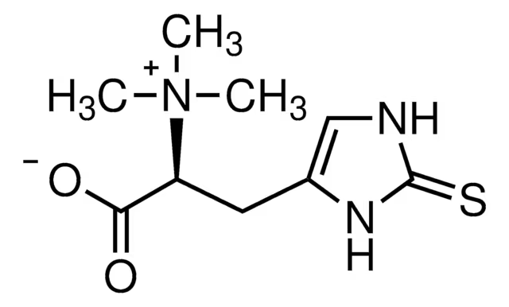
L-Ergothioneine (Ergo)
Ergo is an amino acid and ‘master antioxidant’
Cannot be produced by humans or mammals
Mainly found in mushrooms; transferred to humans via diet of plants or grazing animals.
Unique and specific cellular transporter system in body cells and especially in skin.
Protect against aging and environmental damage. (Liu, 2023)
Neutralize free radicals, reduce inflammation, and support skin vitality and regeneration (Hanayama, 2024; Valachova, 2020)
EXOUSIA PRO
Notes:
L-Ergothioneine is a potent antioxidant used in dermatology to protect skin from oxidative stress, aiding in anti-aging and skin repair. Exosomes serve as delivery vehicles, enhancing the penetration and effectiveness of bioactive compounds like L-Ergothioneine. Combined, they support skin regeneration, reduce inflammation, and improve overall skin health.

Slide 9
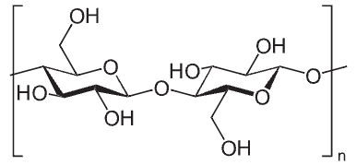
Beta-glucans
Complex sugar (polysaccharide) that comes from natural sources
such as mushrooms.
Benefits:
  Hydration: Helps with dehydrated skin by forming a film on the skin that prevents water loss.
  Anti-aging: Reduces the appearance of wrinkles, redness, irritation, sun damage and uneven skin tone.
  Anti-inflammatory: Reduces inflammation and irritation (Sousa, 2023).
  Skin barrier: Strengthens the skin's natural barrier, protecting it from environmental stressors.
  Healing: Increases cell regeneration and speed up the healing process (Feng, 2025).
  Immune system: Stimulates the skin's immune system, which can help protect against external stressors.
EXOUSIA PRO

Slide 10
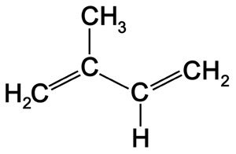
Terpenoids
Terpenoids are bioactive metabolites that can be found in mushrooms and other fungi.
Benefits:
  Anti-inflammatory: Reduces the production of pro-inflammatory factors.
  Anti-microbial: Effective against skin infections (Trepa, 2024)
  Anti-oxidant: Prevent and treat skin cancer.
  Anti-aging: Assist with wrinkles and skin whitening.
  Wound healing: Promote the healing process.
EXOUSIA PRO
Notes:
Terpenoids possess anti-inflammatory and antioxidant properties, making them valuable in treating skin disorders. Exosomes, as cellular messengers, enhance skin regeneration and repair by delivering biomolecules. Combined, terpenoids and exosomes offer innovative therapies in dermatology, targeting aging, pigmentation, and wound healing for enhanced clinical outcomes.

Slide 11
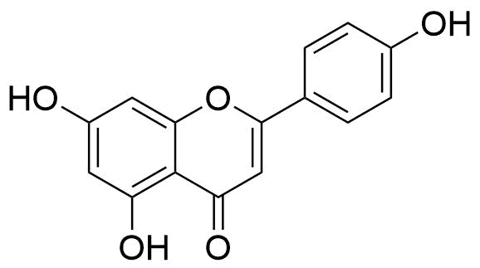
Phenolic compounds
Metabolites naturally found in plants, such as flavonoids, tannins, phenolic acid, salicylic acid, etc.
Action:
  Inhibit enzymes associated with development of human diseases.
  Act as UV screens – flavonoids.
  Antioxidants – plant polyphenols protect against oxidative damage.
  Defense response chemicals – tannins and phytoalexins.
  Acting as humectants, attracting and retaining moisture within the skin.
EXOUSIA PRO

Slide 12
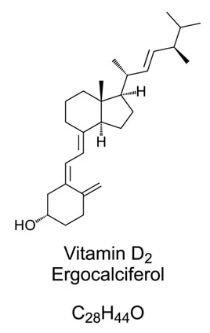
Vitamin D2
Fat-soluble vitamin that has long been known to help the body absorb
and retain calcium and phosphorus.
Mushrooms produce vitamin D2 (ergocalciferol), while animals produce vitamin D3 (cholecalciferol).
Mushrooms exposed to UV light can be a significant source of dietary vitamin D2.
Natural, non-animal source of vitamin D2, making them suitable for vegetarians and vegans.
Important for immune function; enhance macrophage function (Daryabor, 2023).
EXOUSIA PRO

Slide 13
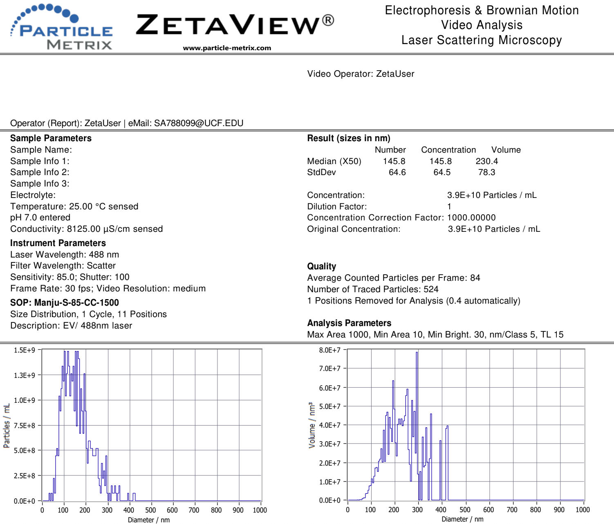
Snapshot
of produced exosome
EXOUSIA PRO

Slide 14
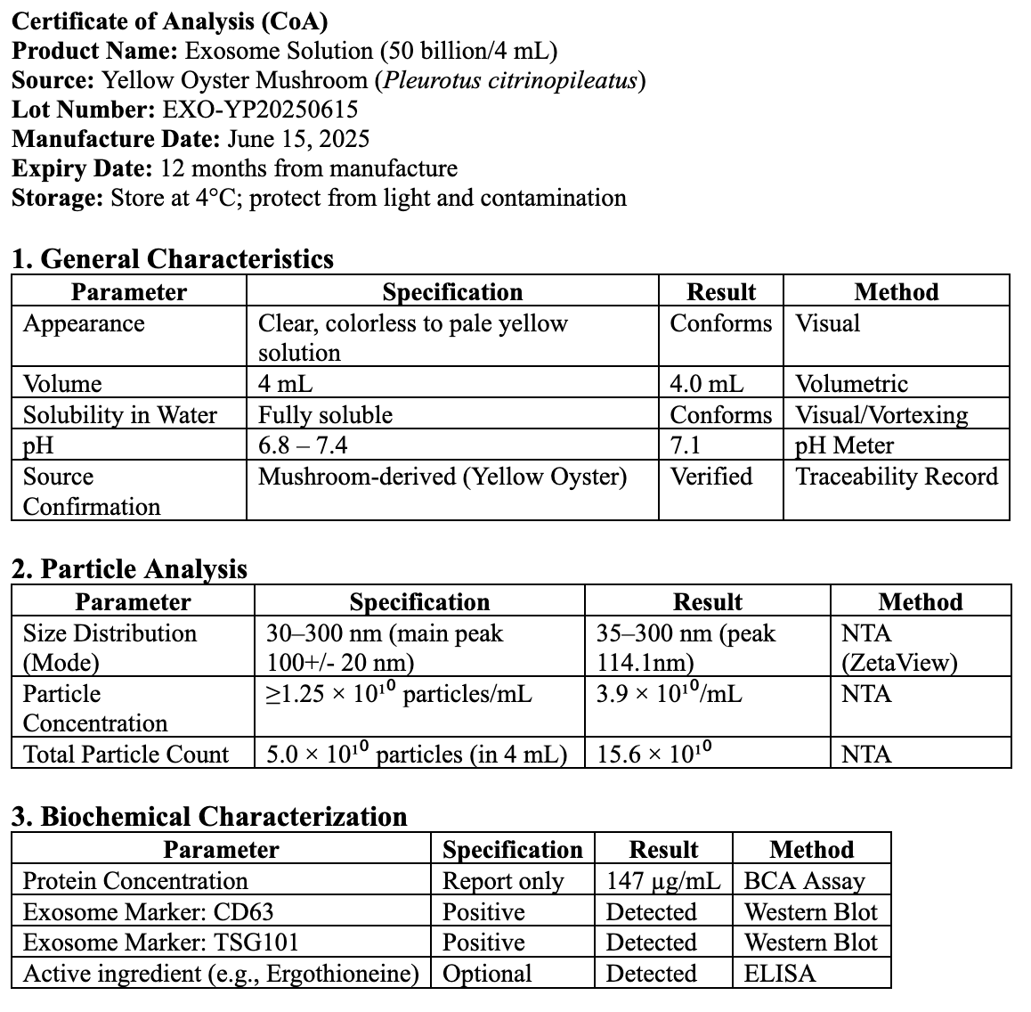
C of A of Yellow Oyster exosome
EXOUSIA PRO

Slide 15
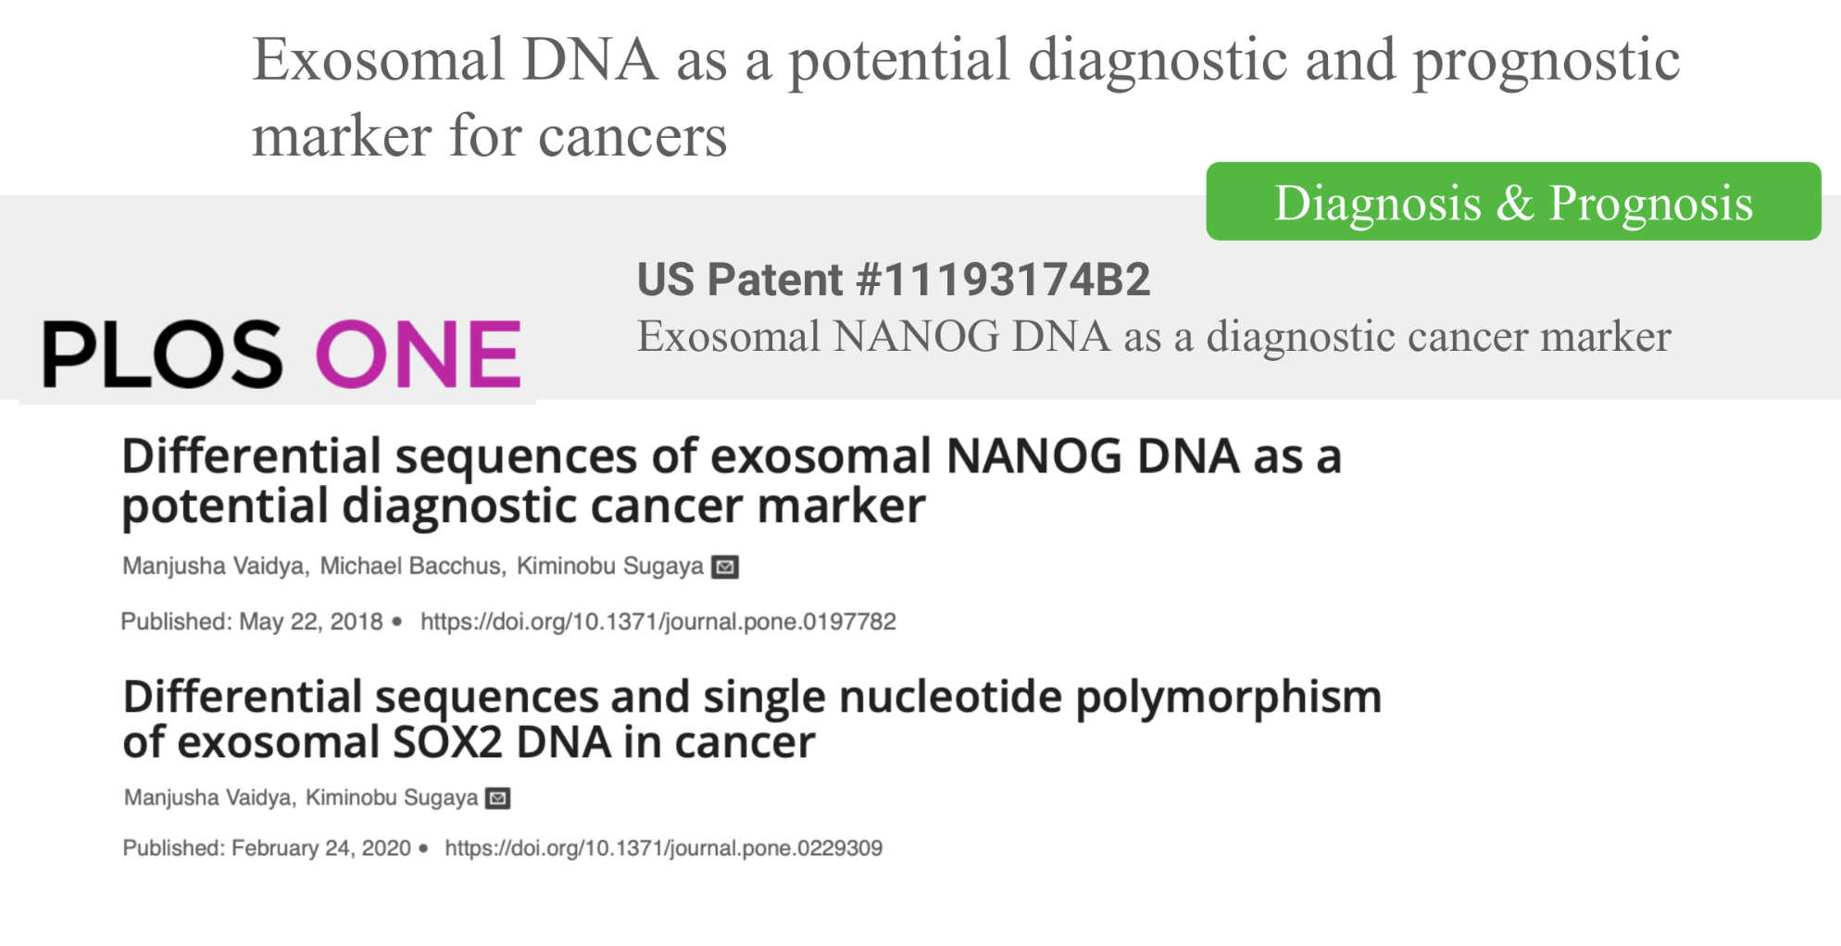
Proprietary Exosome Technology of Exousia Pro and Progenicyte Japan Alliance
EXOUSIA PRO

Slide 16
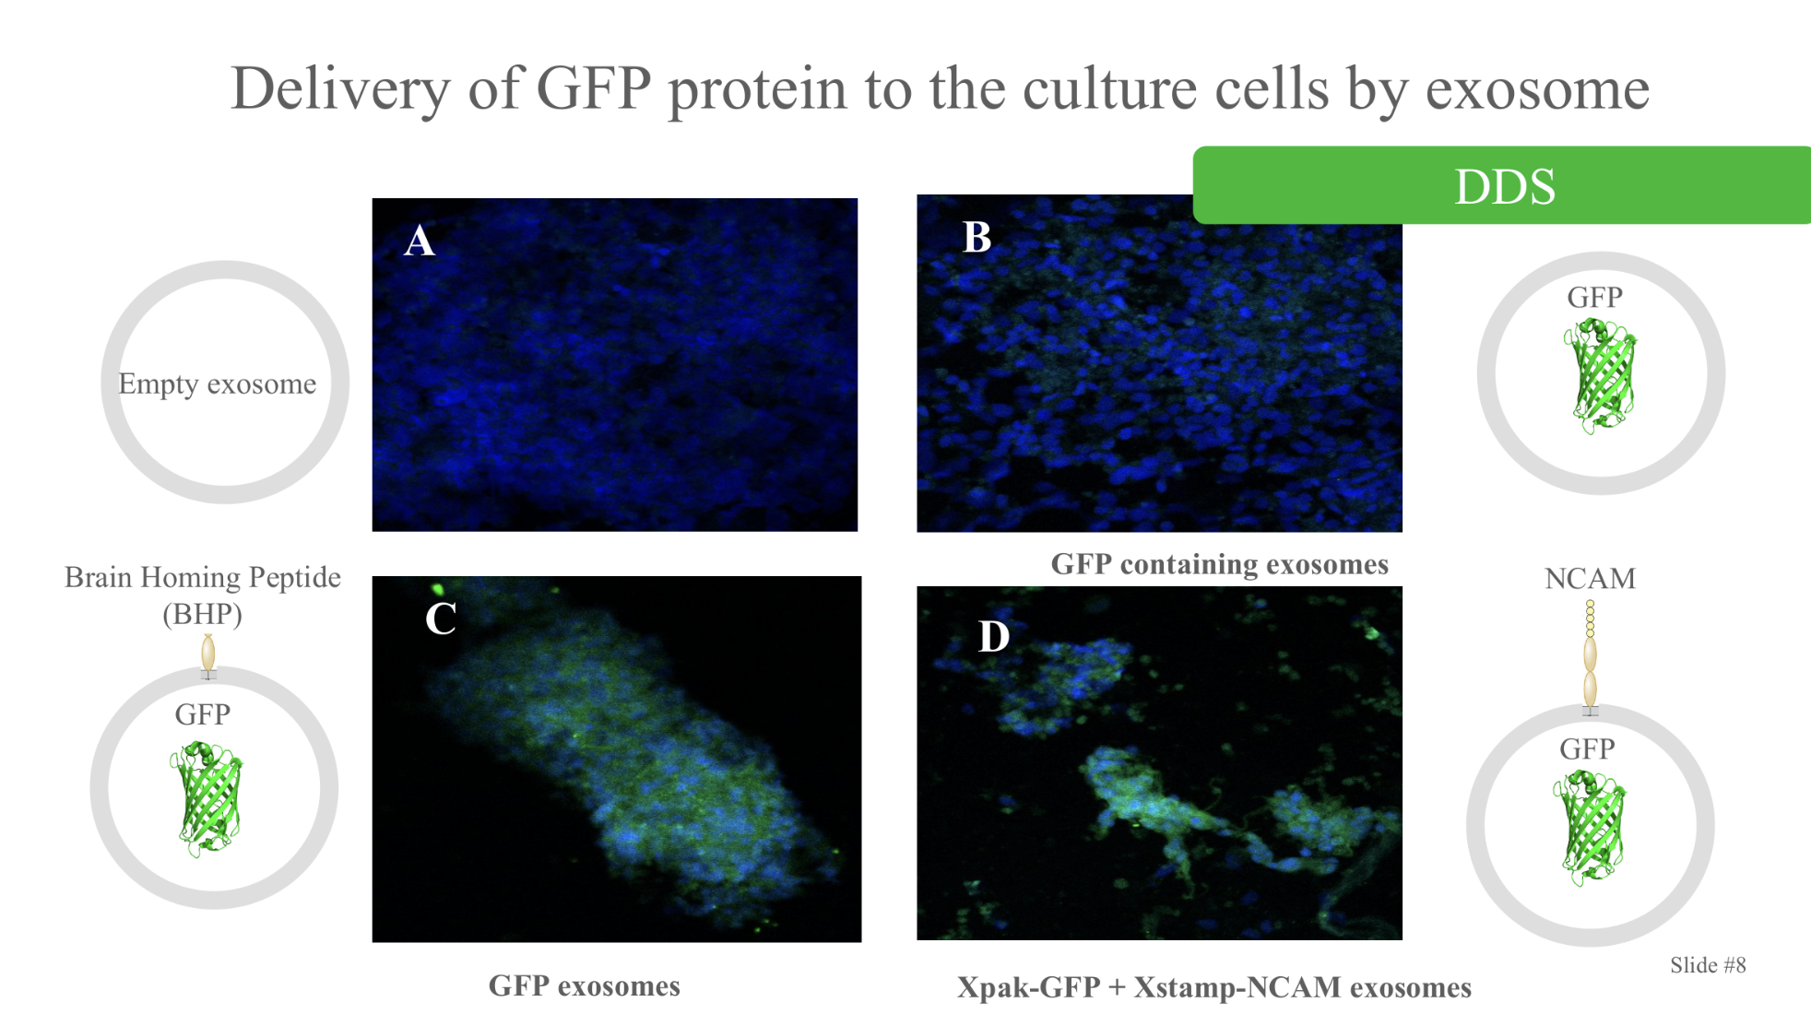
Proprietary Exosome Technology of Exousia Pro and Progenicyte Japan Alliance
EXOUSIA PRO

Slide 17
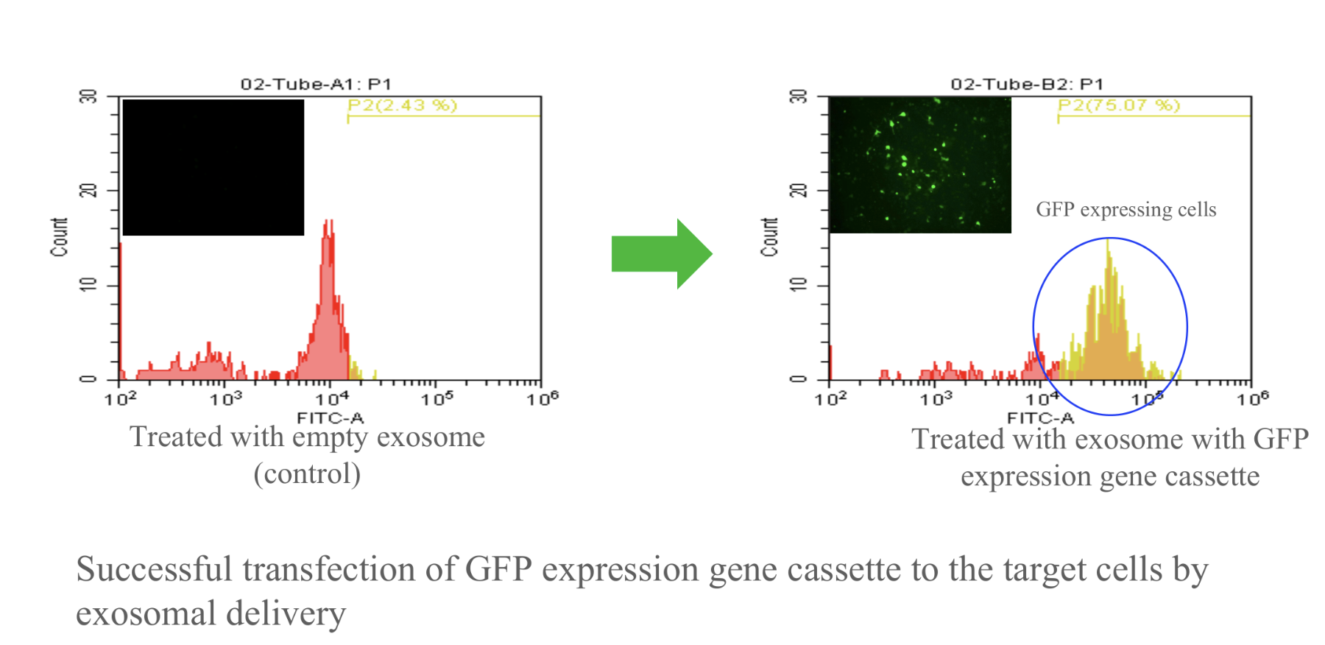
Proprietary Exosome Technology of Exousia Pro and Progenicyte Japan Alliance
EXOUSIA PRO

Slide 18
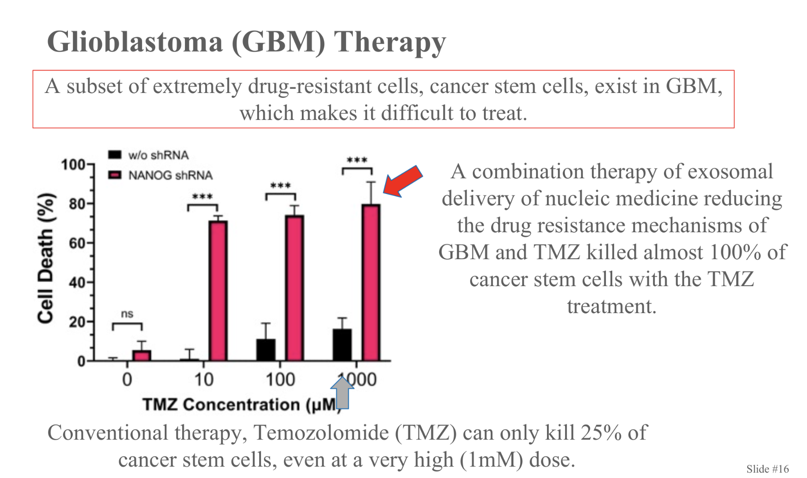
Proprietary Exosome Technology of Exousia Pro and Progenicyte Japan Alliance
EXOUSIA PRO

Slide 19
References
Liu HM, Tang W, Wang XY, Jiang JJ, Zhang W, Wang W. Safe and Effective Antioxidant: The Biological Mechanism and Potential Pathways of Ergothioneine in the Skin. Molecules. 2023 Feb 8;28(4):1648. doi: 10.3390/molecules28041648. PMID: 36838636; PMCID: PMC9967237.
Hanayama Motoki , Mori Koichiro , Ishimoto Takahiro , Kato Yukio , Kawai Junya. 2024. Effects of an ergothioneine-rich Pleurotus sp. on skin moisturizing functions and facial conditions: a randomized, double-blind, placebo-controlled trial. Frontiers in Medicine. Volume 11 - 2024 https://www.frontiersin.org/journals/medicine/articles/10.3389/fmed.2024.1396783 DOI=10.3389/fmed.2024.1396783. ISSN=2296-858X
Valachova K, Svik K, Biro C, Collins MN, Jurcik R, Ondruska L, Soltes L. Impact of Ergothioneine, Hercynine, and Histidine on Oxidative Degradation of Hyaluronan and Wound Healing. Polymers (Basel). 2020 Dec 29;13(1):95. doi: 10.3390/polym13010095. PMID: 33383628; PMCID: PMC7795610.
Sousa, P., Tavares-Valente, D., Amorim, M., Azevedo-Silva, J., Pintado, M., Fernandes, J. 2023. β-Glucan extracts as high-value multifunctional ingredients for skin health: A review, Carbohydrate Polymers, Volume 322, 2023.121329, ISSN 0144-8617, https://doi.org/10.1016/j.carbpol.2023.121329.
Feng X, Shang J, Wang Y, Chen Y, Liu Y. Exploring the Properties and Application Potential of β-Glucan in Skin Care. Food Sci Nutr. 2025 Apr 25;13(4):e70212. doi: 10.1002/fsn3.70212. PMID: 40291929; PMCID: PMC12023766.
Trepa M, Sułkowska-Ziaja K, Kała K, Muszyńska B. Therapeutic Potential of Fungal Terpenes and Terpenoids: Application in Skin Diseases. Molecules. 2024 Mar 6;29(5):1183. doi: 10.3390/molecules29051183. PMID: 38474692; PMCID: PMC10934142.
Gholamreza Daryabor, Nasser Gholijani, Fatemeh Rezaei Kahmini, A review of the critical role of vitamin D axis on the immune system, Experimental and Molecular Pathology, Volumes 132–133, 2023, 104866, ISSN 0014-4800, https://doi.org/10.1016/j.yexmp.2023.104866.
Smith, J., Field, M., & Sugaya, K. (2025). Brain-Homing Peptide Expression on the Membrane Enhances the Delivery of Exosomes to Neural Cells and Tissue. Neuroglia, 6(1), 3. https://doi.org/10.3390/neuroglia6010003
Sayeed N, Sugaya K. (2022) Exosome-mediated Tom40 delivery protects against hydrogen peroxide-induced oxidative stress by regulating mitochondrial function. PLoS One. ;17(8):e0272511. doi: 10.1371/journal.pone.0272511.
Vaidya, M.; Sugaya, K.*. (2020) Differential sequences and single nucleotide polymorphism of exosomal SOX2 DNA in cancer PLoS ONE 15(2): e0229309. https://doi.org/10.1371/journal.pone.0229309
EXOUSIA PRO

